Slide 1



eze
Cloud Based Monitoring

Slide 2
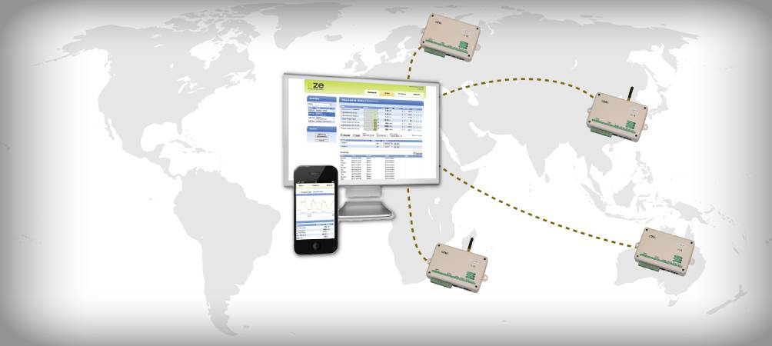

Anywhere access
Real time and historic access
Standard web browser – no software
Secure and easy to use.

Slide 3
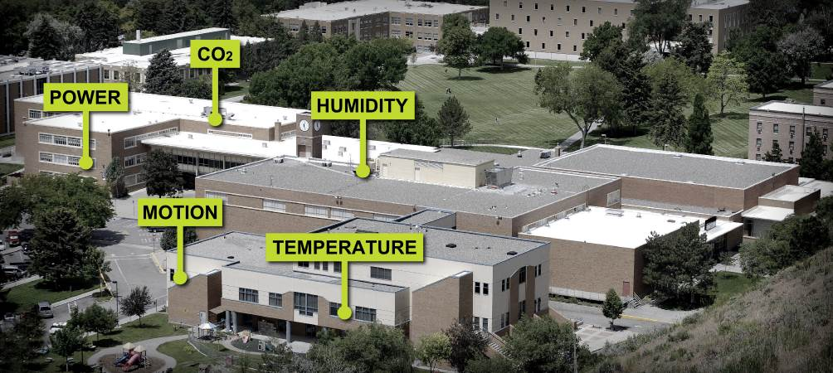
Alerts and Alarms
Flexible alarming system
Multiple thresholds
  Email
  SMS
  Voice
  API

Slide 4

Automatic Reports
PDF reports in your email
Automatic daily, weekly or monthly
Graphics and summary data
CSV file ready for other software

Slide 5

Simple Dashboard
Configurable, drag-and-drop blocks
Real time and historic data
View status from multiple sites
Both Shared and Private

Slide 6
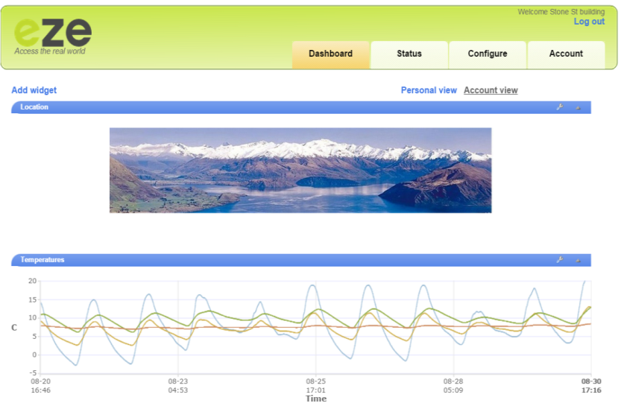

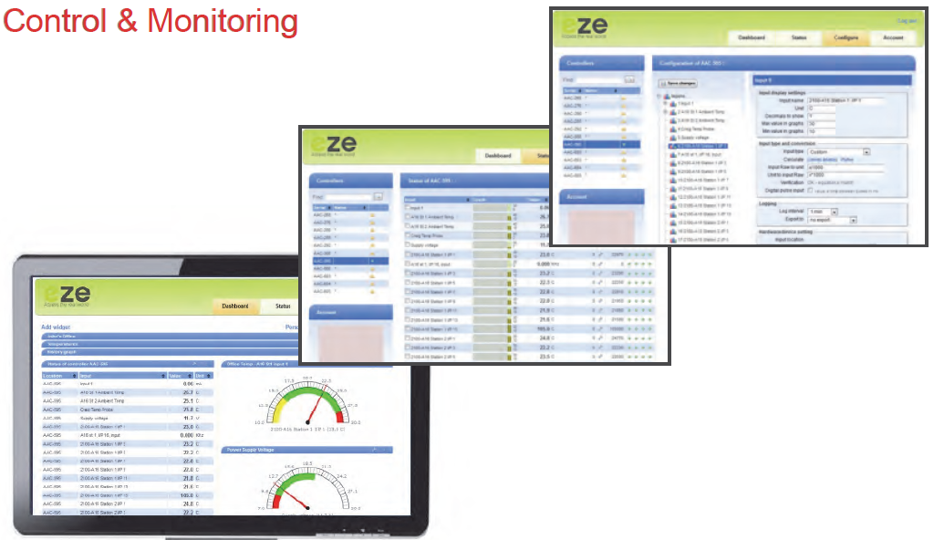
Simple Dashboard
eze User Interface incorporates configurable
user friendly Web browser screens
A complete Cloud Based Monitoring and Control System.

Slide 7
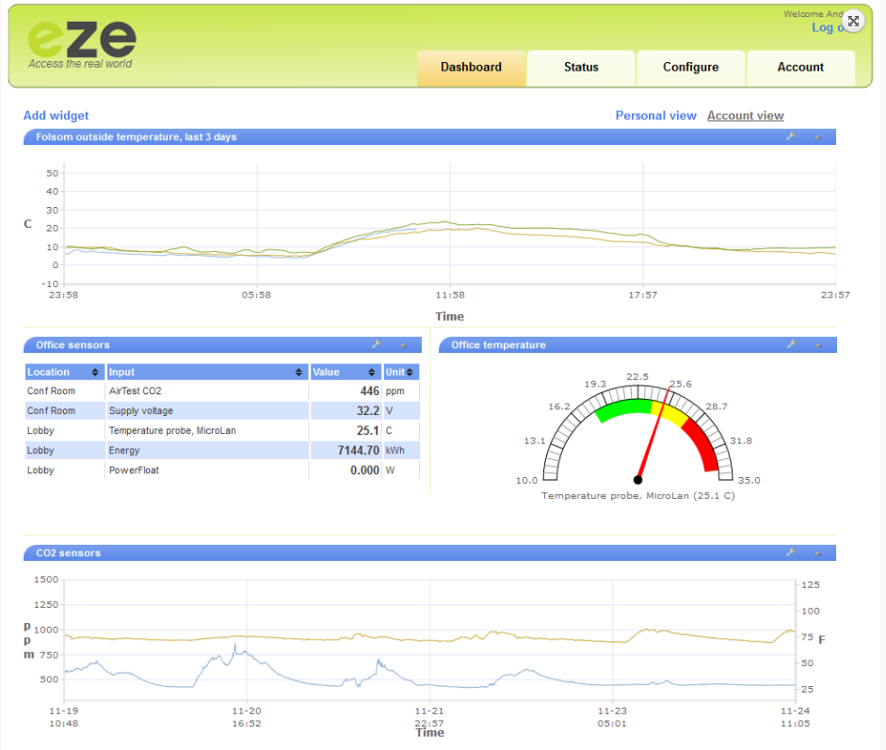
Simple Dashboard

Slide 8
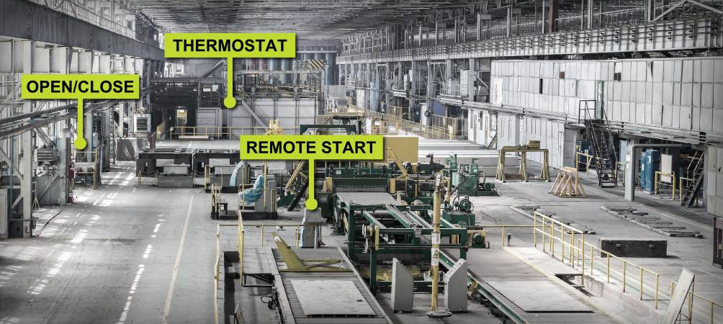
Control and Automate
Web browser based – no software to install
Real time and historic graphs
Easy to use analytic tools

Slide 9
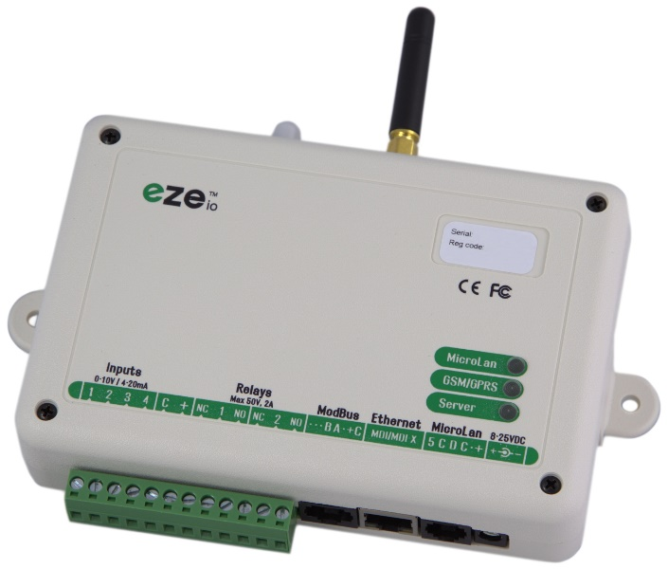
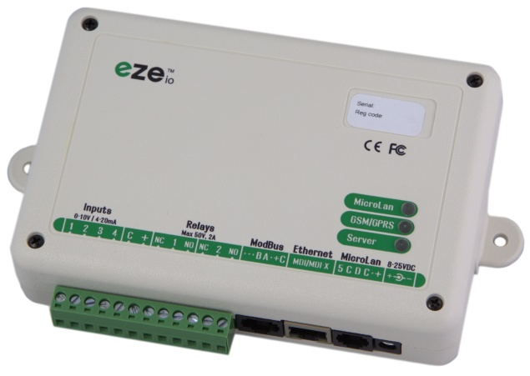
The Ezeio Controller
The ezeio Controller comes ready to use to start monitoring, logging and controlling over the Internet.
As soon as the controller is connected to power and an Internet connection, it will start communicating with the eze System servers. There is no need for special software or network setup. The ezeio connection is encrypted, bidirectional and very efficient.
The ezeio comes complete with a power supply and Ethernet cable. Additional service is easily purchased via the web interface. Access to the web UI for configuration and live data is free for life.
ezeio-STD
ezeio-GSM

Slide 10
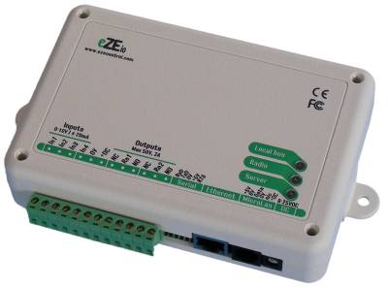
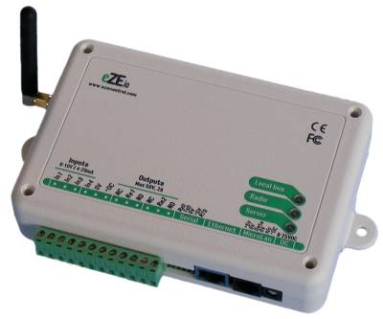
Two ezeio Controller Models
General Features:
4 analogue general purpose inputs
(0-10V / 4-20mA / S0-pulse / digital).
2 general purpose relay outputs (max 50V@2A).
ModBus-RTU compatible serial port.
Standard Ethernet 10/100 port.
Runs on 8-25VDC, <1W typical draw.
Logging interval configurable from 10 seconds up to 4 hours for each input.
Up to four alarm thresholds for every input.
Alarms can send txt, email, voice, control outputs, set modes and more.
Live access from standard web interface.
No on-site configuration required.
ezeio – Standard
Ethernet
GSM Features:
Built-in GSM cell phone transceiver.
Automatic fail-over to GSM if hardwired Ethernet is not available.
ezeio – GSM
Ethernet & GSM

Slide 11
ezeio Functions
Measure and Monitor
Collect real time data and store it on the web.
Log and Analyse
Secure, redundant data storage, download/export or analyse on the web.
Supervise and Alarm
Email, SMS, and Phone alarms. Direct access from web & cell phone.
Control and Automate
Instant remote control, program automatic actions.
Visualise and Report
Increase visibility, awareness and create better understanding.

Slide 12
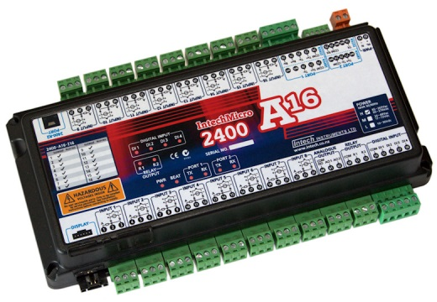
Easy expansion for ezeio controllers
Intech 2100-A16 plus 2400-A16
This field station connects directly to the eze
controller via the Modus RTU port. Up to two
fully loaded 2400-A16s can be connected to one
eze controller.
Features:
  Up to 16 Isolated Universal Analogue Inputs.
    RTD: Pt100/Pt1000, -200~320°C to -200~800°C.
    T/C: B, E, K, J, N, R, S, T, with CJC.
    mA: 0~20mA, 0~2.5mA.
    mV: -25~25mV to -200~200mV.
    V: 0~1V to 0~15V.
    Pulse/Digital: Meter pulses, Counting and Frequency. Max speed 2500Hz.
  4 Dedicated Digital Inputs.
  2 Relay Outputs.
  2 Analogue 4~20mA Outputs.

Slide 13
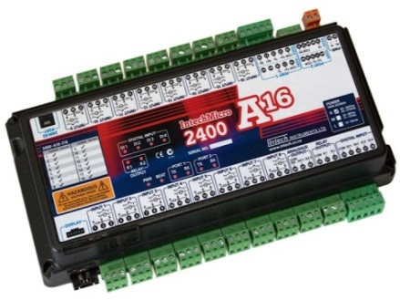
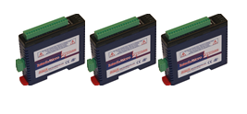
Inputs capacity
RS485
Up to 40 inputs max per ezeio.
4 eze Inputs – can be a mixture of 4~20mA or pulse (digital).
2400-A16-I16
16 Universal analogue or pulse inputs
4 Digital inputs (state or pulse).
2300 series mini stations:
Temperature probes, 4~20mA, mV & V, Relay outputs & Digital inputs.

Slide 14


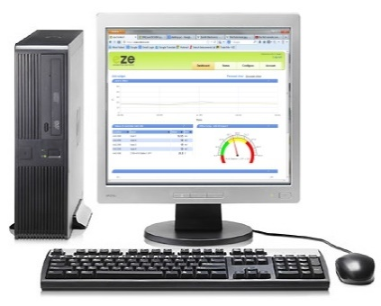
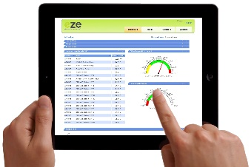
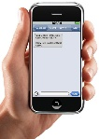
Collecting and sending data to the Cloud
Temperature
Signals
(4~20mA)
ezeio controller
mobile
tablet
PC

Slide 15
ezeio Special Features
What happens when the connection to the web is lost?
Eze SCADA
servers
The ezeio stores data and when the connection is restored,
the ezeio passes on the stored data to the web. There is no loss of data.
2. All local alarm points and configurations are stored in the ezeio to ensure operations remain normal during connection failure.

Slide 16
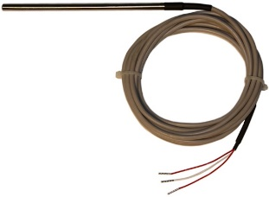
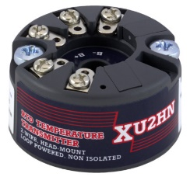
Ezeio Monitoring – Schematic Example 1
1 to 4 inputs
30 Temperatures
Across New Zealand
Alarm set point on every probe.
Ezeio-GSM
RL-S Probes
XU2HN
Transmitter

Slide 17
Eze Connection & Wiring (4~20mA)

Slide 18

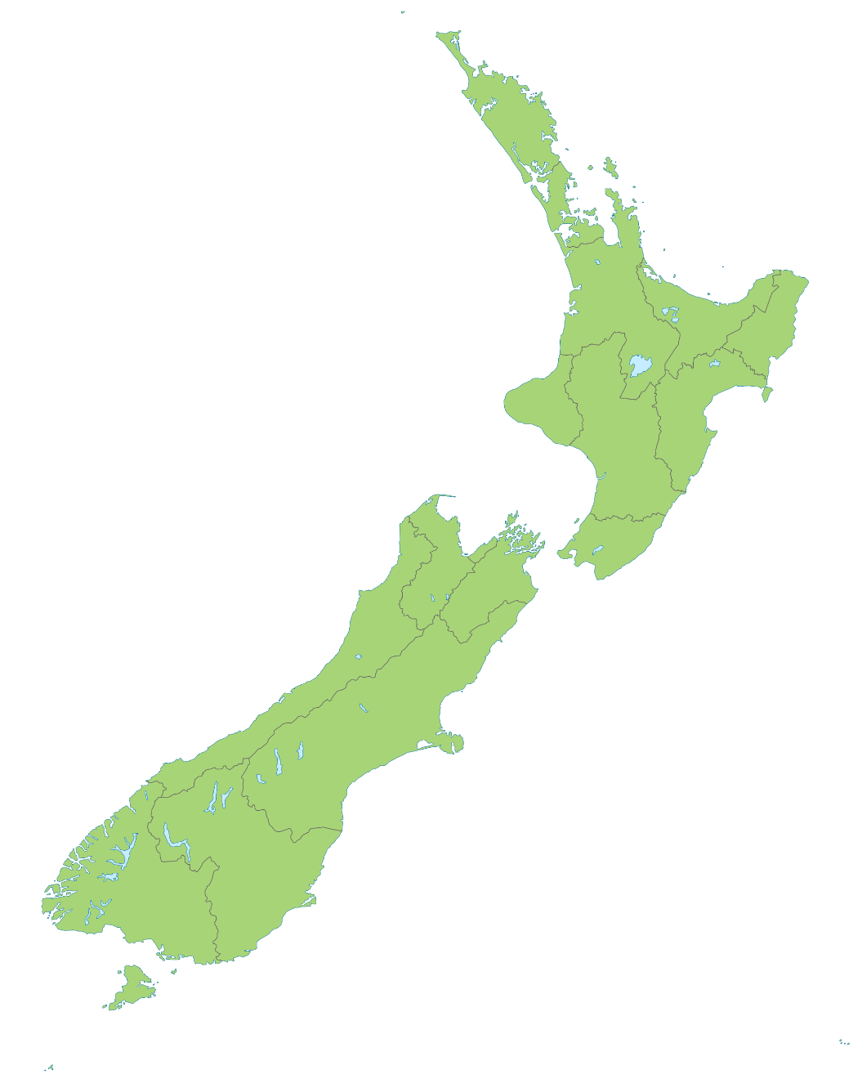
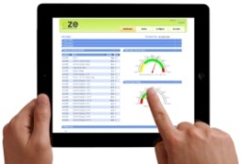

eze Example Site Installation
Screen visible
on PC in Main location
eze
servers
Different ezeio controllers throughout the country

Slide 19


Ezeio Monitoring – Schematic Example 2
Ezeio Controller
Eze SCADA
servers
Client PC
(Like a MicroScan
Passive PC)
Field Stations
2100-A16 & 2300 series
The web interface allows you to customise and view results, change set-points, and download data sets.
Field Sensors

Slide 20
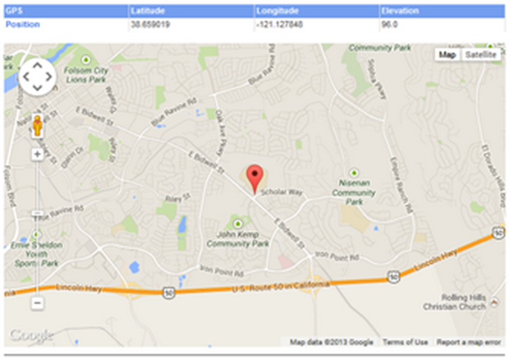
eze GPS Positioning Facility
Simply plug in the optional GPS antenna.
When the controller has a fix on its position,
a Position-link on your status screen.

Slide 21
Fast Results
Simple Installation
Connect sensor, network, and power. Done!
Infrastructure Already In Place
No special software to install, no servers, no network changes, no start-up costs.
Direct Access to Data
Log in from with any internet browser, anywhere, anytime. Multiple user access at the same time.
Quick Analysis
All you data is available online, or to download and process locally.

Slide 22

eze Controller Safety Features
No ports open to attack:
The remote assets are invisible to the internet.
No special software to install.
Built in data logging using a backed-up secure
database also hidden from direct internet contact.
All data sent by secure encrypted channel.
Centralized password management: no more passwords at each site.
Software upgrades are automatically done over the internet.
Can send data securely to an enterprise system with the user's own interface.

Slide 23

More eze SCADA Features
Multiple ezeio controllers per installation – ideal for sites covering a large area
Works with most types of sensor (including existing installations).
Relay outputs for local alarm, pump, motor or lighting controls etc.
Alarms on any input, annunciation by email, text message or direct control of outputs.
User interface is a standard browser, e.g. :such Firefox, Chrome, Safari, or IE.

Slide 24
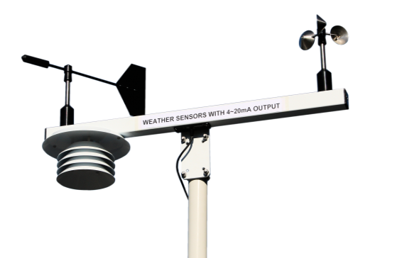
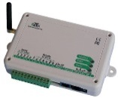
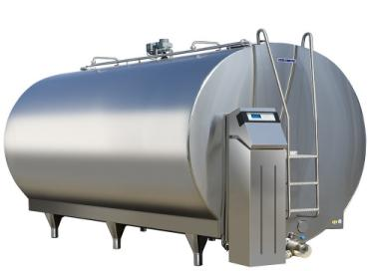
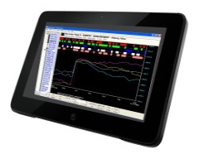
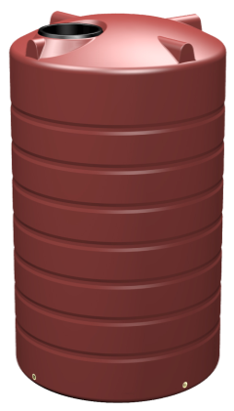
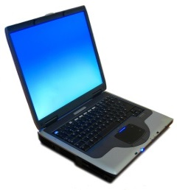

eze and popular applications
Weather Station
Silo Storage
Eze SCADA
servers
Water Storage
Effluent Storage
and Disposal

Slide 25
Questions?
Intech Instruments Ltd.
www.intech.co.nz

